Slide 1

CLEAN CODE .NET

Slide 2
CLEAN CODE
Writing code that’s easy to read, understand, and maintain is every developer’s goal. Clean code practices and SOLID principles in C# can help you achieve that goal. Let’s dive into what clean code and SOLID principles are, and how you can implement them in your C# projects.
Notes:
https://www.bytehide.com/blog/important-tips-to-writing-clean-csharp-code

Slide 3
Why Clean Code Matters
It goes beyond merely being aesthetically pleasing to write code that is simple to read, alter, and maintain. Clean code is important for the following reasons:
1. Readability: Clean code is easy to read and understand. Anyone looking at your code should be able to comprehend its purpose and functionality without struggling.
2. Maintainability: Clean code is easier to maintain. When you need to make changes or fix bugs, clean code minimizes the chances of introducing new issues.
3. Collaboration: Clean code promotes collaboration within development teams. It allows team members to work on the same codebase more effectively.
4. Efficiency: Clean code can lead to more efficient software. It reduces the chances of performance bottlenecks and unintended consequences.

Slide 4
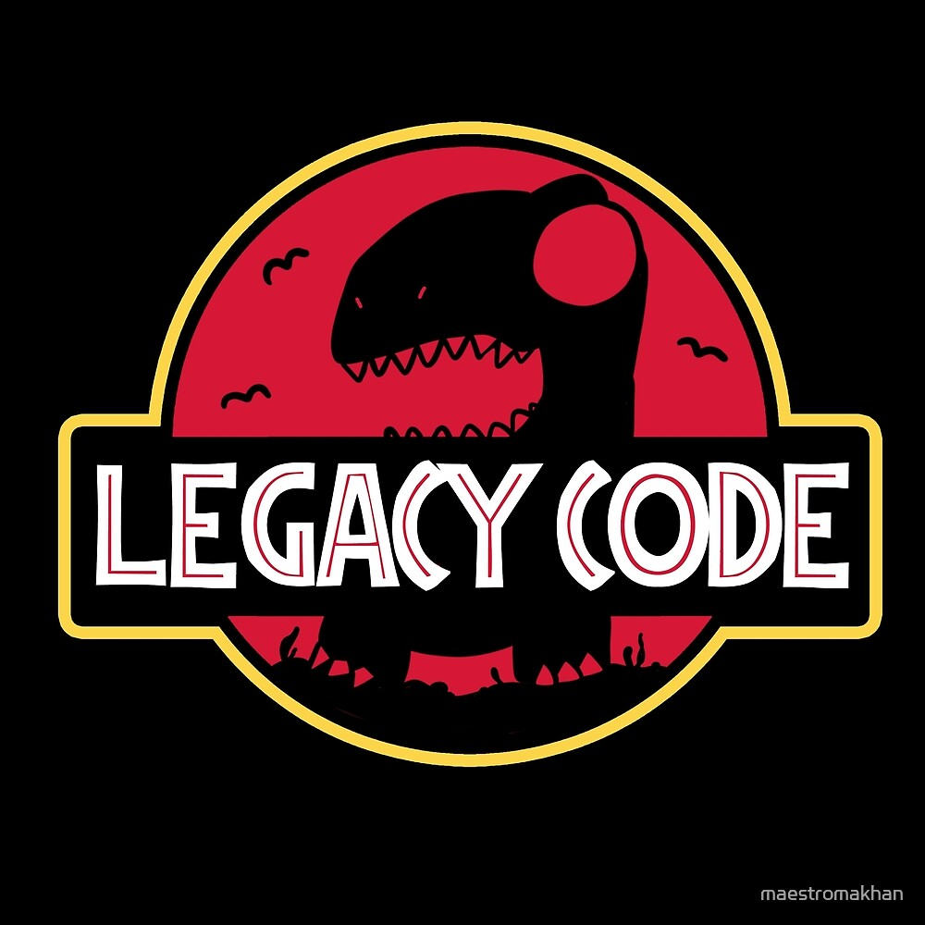

Slide 5
Use variable names that are easy to remember
Bad way:
var yyyymmdstr = DateTime.Now.ToString("YYYY/MM/DD")
Good way:
var currentDate = DateTime.Now.ToString("YYYY/MM/DD")

Slide 6
Use variable names with the same structure
Bad way:
getUserInfo();
getClientData();
getCustomerRecord();
Good way:
getUser();

Slide 7
Use searchable names
Bad way:
// In the future we will not remember what 86400000 means.
clearBacklog(backlog, 86400000);
Good way:
// Declare constants with a searchable name
var MILLISECONDS_PER_DAY = 60 * 60 * 24 * 1000; //86400000;
clearBacklog(backlog, MILLISECONDS_PER_DAY);

Slide 8
Don’t repeat yourself
Bad way
Bike MountainBike = new(){
bikeBrand = "Trek",
bikeModel = "MX Mountain",
bikeColor = "Green"
};
void paintBike(Bike mountainBike, string color){
mountainBike.bikeColor = color;
}

Slide 9
Good way:
Bike MountainBike = new(){
brand = "Trek",
model = "MX Mountain",
color = "Green"
};
void paintBike(Bike mountainBike, string color){
mountainBike.color = color;
}

Slide 10
Uses highly descriptive variable names
Bad way:
const address = "One Infinite Loop, Cupertino 95014";
var cityZipCodeRegex = new Regex(@"/ ^[^,\\] +[,\\\s] + (.+?)\s * (\d{ 5 })?$/").Matches(address);
saveCityZipCode(
cityZipCodeRegex[0].Value,
cityZipCodeRegex[1].Value
);
Good way:
var address = "One Infinite Loop, Cupertino 95014";
var cityZipCodeRegex = new Regex(@"/ ^[^,\\] +[,\\\s] + (.+?)\s * (\d{ 5 })?$/").Matches(address);
var city = cityZipCodeRegex[0].Value;
var zipCode = cityZipCodeRegex[1].Value;
saveCityZipCode(city, zipCode);

Slide 11
Always encapsulate conditionals
Bad way:
if (website.state == "down")
{
// ...
}
Good way:
if (website.IsDown())
{
// ...
}

Slide 12
Use private/protected members
Bad way:
class Car
{
public string Brand { get; set; }
public Car(string brand)
{
Brand = brand;
}
}
var car = new Car("Porsche");
Console.WriteLine(car.Brand); // Car brand: Porsche

Slide 13
Good way:
class Car
{
public string Brand { get; }
public Car(string brand)
{
Brand = brand;
}
}
var car = new Car("Porsche");
Console.WriteLine(car.Brand); // Car brand: Porsche

Slide 14
Learn to use setters and getters
Bad way:
class BankAccount
{
public double Balance = 5000;
}
var bankAccount = new BankAccount();
// Buy a cappuccino ☕️ ...
bankAccount.Balance -= 15;

Slide 15
Good way:
class BankAccount
{
private double _balance = 0.0D;
public double Balance {
get {
return _balance;
}
}
public BankAccount(balance = 1000)
{
_balance = balance;
}

Slide 16
public void WithdrawBalance(int amount)
{
if (amount > _balance)
{
throw new Exception('Amount greater than available balance.');
}
_balance -= amount;
}
public void DepositBalance(int amount)
{
_balance += amount;
}
}
var bankAccount = new BankAccount();
// Buy a cappuccino ☕️ ...
bankAccount.WithdrawBalance(price: 15);
balance = bankAccount.Balance;

Slide 17
Composition is better than inheritance
Bad way:
class Car
{
private string Model { get; set; }
private string Brand { get; set; }
public Car(string model, string brand)
{
Model = model;
Brand = brand;
}
// ...
}
// Bad because Car "have" engine data.
// CarEngineData is not a type of Car
class CarEngineData : Car
{
private string Model { get; set; }
private string Brand { get; set; }
public CarEngineData(string model, string brand, string displacement, string horses)
{
// ...
}
// ...
}

Slide 18
Good way:
class CarEngineData
{
public string Displacement { get; }
public string Horses { get; }
public EmployeeTaxData(string displacement, string horses)
{
Displacement = displacement;
Horses = horses;
}
// ...
}

Slide 19
class Car
{
public string Model { get; }
public string Brand { get; }
public CarEngineData EngineData { get; }
public Car(string model, string brand)
{
Model = model;
Brand = brand;
}
public void SetEngine(string displacement, double horses)
{
EngineData = new CarEngineData(displacement, horses);
}
// ...
}

Slide 20
Don’t use magic chains
Bad way:
if (userRole == "Admin")
{
// logic in here
}
Good way:
const string ADMIN_ROLE = "Admin"
if (userRole == ADMIN_ROLE)
{
// logic in here
}

Slide 21
Limiting function arguments
Bad way:
public void ProtectApplication(string path, string configurationPath, string outPutPath, CancellationToken cancellationToken)
{
// ...
}
Good way:
public class ProtectionConfig
{
public string Path { get; set; }
public string ConfigurationPath { get; set; }
public string OutPutPath { get; set; }
public CancellationToken cancellationToken { get; set; }
}
var config = new ProtectionConfig
{
Path = "./app.exe",
ConfigurationPath = "./shield.config.json",
OutPutPath = "./app_protected.exe",
CancellationToken = source.Token;
};
public void ProtectApplication(ProtectionConfig config)
{
// ...
}

Slide 22
Name the functions with what they do
Bad way:
public class SlackNotification
{
//...
public void Handle()
{
SendMessage(this._to, this._files, this._body);
}
}
var message = new SlackNotification(...);
// What is this? A handle for the message? Are we writing to a file now?
message.Handle();

Slide 23
Good way:
public class SlackNotification
{
//...
public void Send()
{
SendMessage(this._to, this._files, this._body);
}
}
var message = new SlackNotification(...);
// Clear and obvious
message.Send();

Slide 24
Never save unused code
Bad way:
public void OldRequestMethod(string url)
{
// ...
}
public void NewRequestMethod(string url)
{
// ...
}
var request = NewRequestMethod(requestUrl);
SlackChannel("bytehide", request, "get users");
Good way:
public void RequestMethod(string url)
{
// ...
}
var request = RequestMethod(requestUrl);
SlackChannel("bytehide", request, "get users");

Slide 25
One level of abstraction per function
Bad way:
public string ParseBetterJSAlternative(string code)
{
var regexes = [
// ...
];
var statements = explode(" ", code);
var tokens = new string[] {};
foreach (var regex in regexes)
{
foreach (var statement in statements)
{
// ...
}
}
var ast = new string[] {};
foreach (var token in tokens)
{
// lex...
}
foreach (var node in ast)
{
// parse...
}
}

Slide 26
Good way:
class Tokenizer
{
public string Tokenize(string code)
{
var regexes = new string[] {
// ...
};
var statements = explode(" ", code);
var tokens = new string[] {};
foreach (var regex in regexes)
{
foreach (var statement in statements)
{
tokens[] = /* ... */;
}
}
return tokens;
}
}

Slide 27
Never write in global functions
Bad way:
public Dictionary<string, string> Config()
{
return new Dictionary<string,string>(){
["product"] = "shield"
};
}

Slide 28
Good way:
class Configuration
{
private Dictionary<string, string> _configuration;
public Configuration(Dictionary<string, string> configuration)
{
_configuration = configuration;
}
public string[] Get(string key)
{
return _configuration.ContainsKey(key) ? _configuration[key] : null;
}
}

Slide 29
Avoid magic numbers and strings
Bad Example:
if (order.Quantity > 10)
{
totalPrice *= 0.9; // 10% discount
}
if (order.Quantity > 10) { totalPrice *= 0.9; // 10% discount }
Good Example:
const int DiscountThreshold = 10;
const decimal DiscountRate = 0.9m;
if (order.Quantity > DiscountThreshold)
{
totalPrice *= DiscountRate;
}
const int DiscountThreshold = 10; const decimal DiscountRate = 0.9m; if (order.Quantity > DiscountThreshold) { totalPrice *= DiscountRate; }

Slide 30
Comments and documentation
public class TemperatureConverter
{
public double ConvertToFahrenheit(double celsius)
{
// The formula for converting Celsius to Fahrenheit (C * 9/5) + 32 is derived
// from the relation between the two temperature scales.
return (celsius * 9 / 5) + 32;
}
}
Notes:
https://engx.space/global/en/blog/c-sharp-clean-code

Slide 31
/// <summary>
/// Calculates the total price with tax included.
/// </summary>
/// <param name="price">The base price.</param>
/// <param name="taxRate">The applicable tax rate.</param>
/// <returns>The total price including tax.</returns>
decimal CalculateTotalWithTax(decimal price, decimal taxRate)
{
return price + (price * taxRate);
}

Slide 32
Keep Functions and Methods Small
Small functions and methods are integral to clean code for several reasons:
1. Readability Small functions are more readable. When a function is concise and focused on a single task, it is easier for anyone reading the code to understand what it does.
2. Maintainability Smaller functions are easier to maintain. When a change is required, you don’t need to comprehend the entire function; you can focus on the specific part related to the change.
3. Reusability Smaller functions are more reusable. They can be used in different contexts because they perform specific, well-defined tasks.
4. Testing Small functions are more testable. When functions have a single responsibility, it’s easier to write unit tests that cover specific cases and behaviors.
5. Debugging Debugging is simpler with smaller functions. When an issue arises, you can quickly pinpoint the function or method responsible, making debugging less time-consuming.
6. Encapsulation Smaller functions naturally follow the principle of encapsulation, isolating a specific piece of functionality. This can lead to better code organization.

Slide 33
How to Keep Functions and Methods Small
To keep functions and methods small, consider the following practices:
1. Single Responsibility Each function or method should have a single responsibility. If you find a function doing too much, break it into smaller functions that handle specific tasks.
2. Descriptive Names Give your functions and methods descriptive names that clearly indicate their purpose. A well-named function often obviates the need for comments.
3. Limit Line Count A rule of thumb is to keep functions and methods around 10-20 lines of code. If a function is significantly longer, consider whether it can be broken down.
4. Nested Functions Consider using nested functions when it makes sense. This can help organize code and keep related functionality together.
5. Use Helper Functions Create small helper functions to encapsulate common or repeated logic. This promotes code reuse and reduces duplication.
6. Review and Refactor Regularly review your code and refactor functions that have grown too large. Refactoring is an essential part of maintaining clean code.

Slide 34

Repo extra info
https://github.com/thangchung/clean-code-dotnet

Slide 35

Notes:
Duplicado de CleanCode-1_Guru

Slide 36
LAB 1

Slide 37
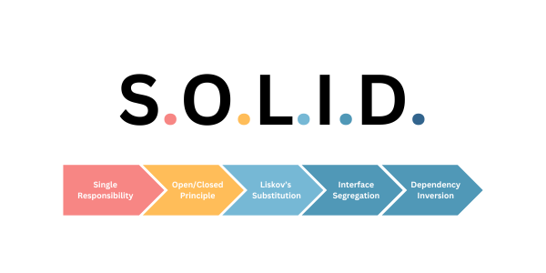
Notes:
https://www.c-sharpcorner.com/UploadFile/damubetha/solid-principles-in-C-Sharp/

Slide 38
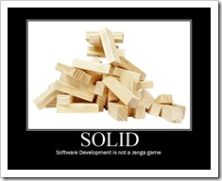

Slide 39
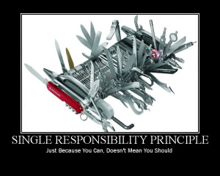
The Single Responsibility Principle

Slide 40
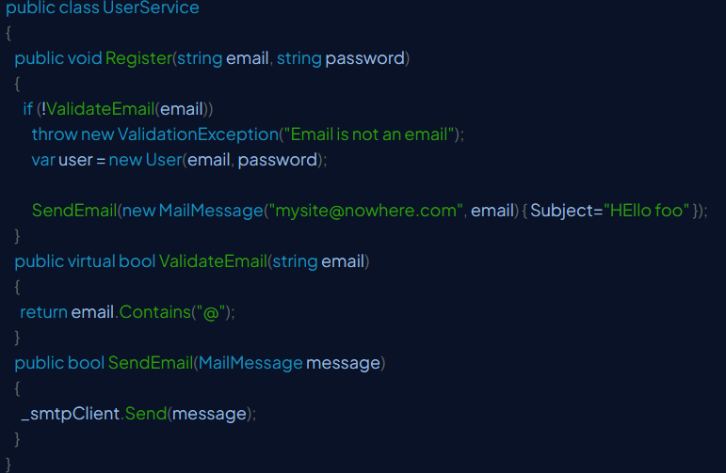
BAD

Slide 41
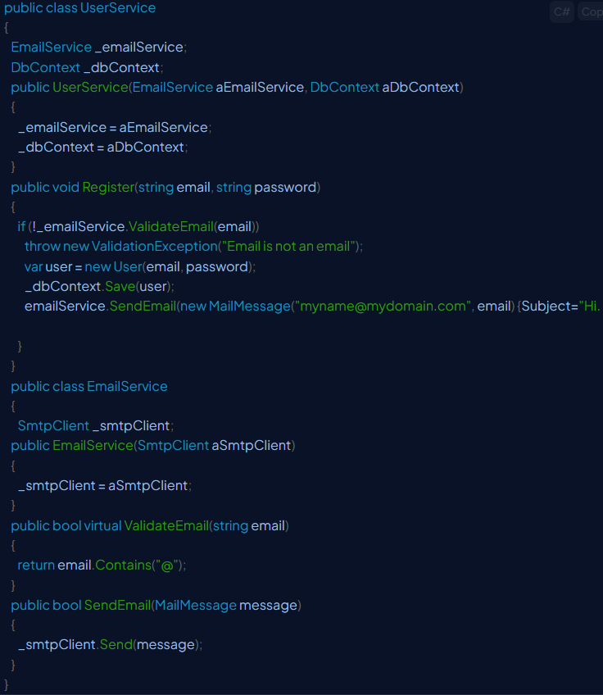
OKEY

Slide 42

The Open Closed Principle

Slide 43
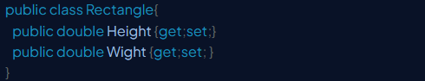

Slide 44
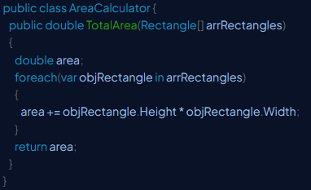

Slide 45
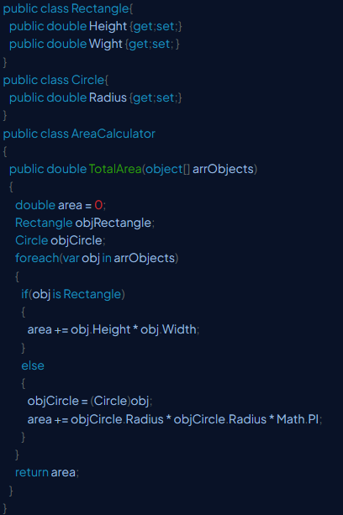

Slide 46
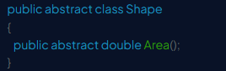

Slide 47
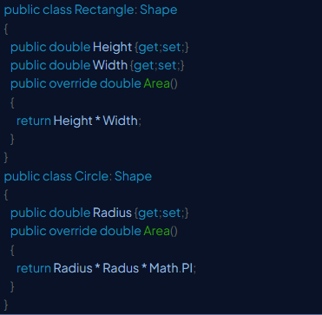

Slide 48
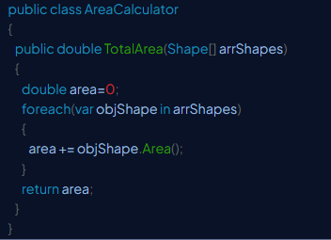

Slide 49
public class AreaCalculator
{
public double TotalArea(Shape[] arrShapes)
{
double area=0;
foreach(var objShape in arrShapes)
{
area += objShape.Area();
}
return area;
}
}

Slide 50
LAB 2

Slide 51
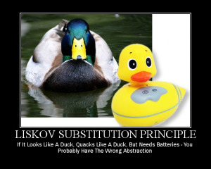
The Liskov Substitution Principle

Slide 52
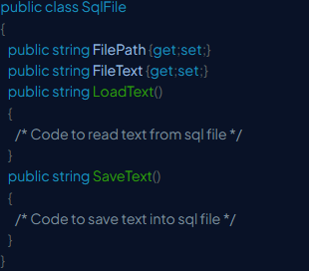
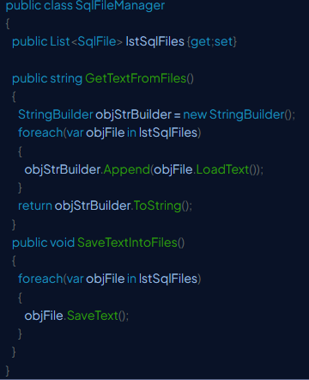

Slide 53
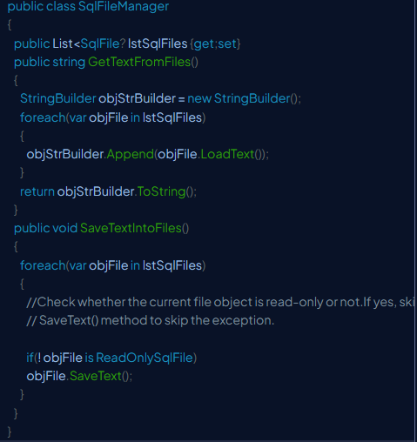

Slide 54
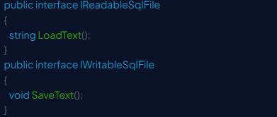

Slide 55
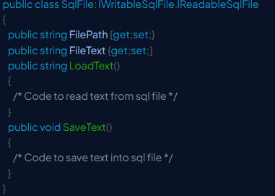

Slide 56
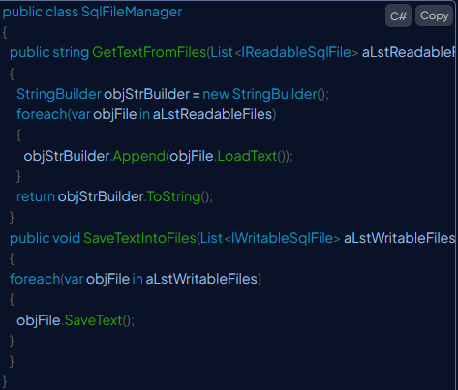

Slide 57
LAB 3

Slide 58
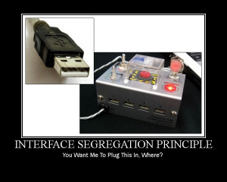
The Interface Segregation Principle

Slide 59
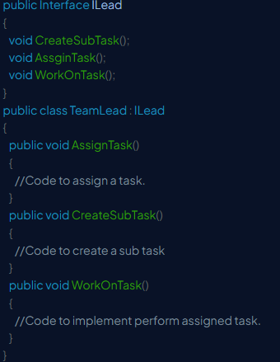

Slide 60
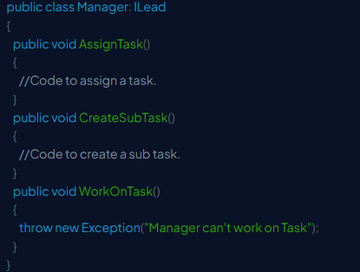

Slide 61
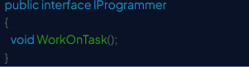
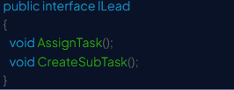

Slide 62
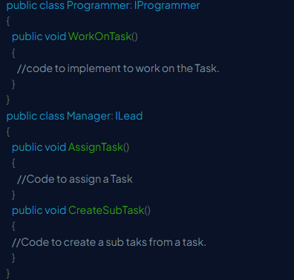

Slide 63
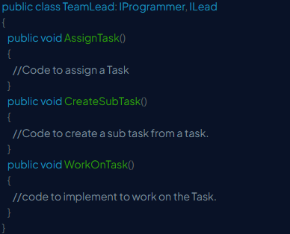

Slide 64
LAB 4

Slide 65
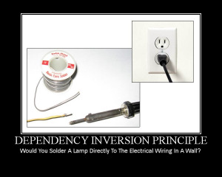
The Dependency Inversion Principle

Slide 66
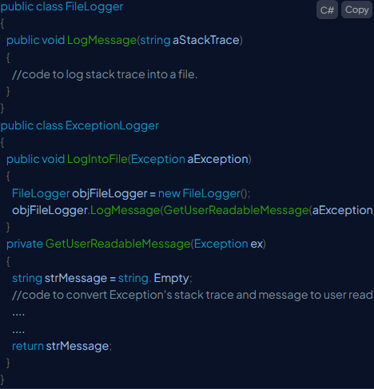

Slide 67
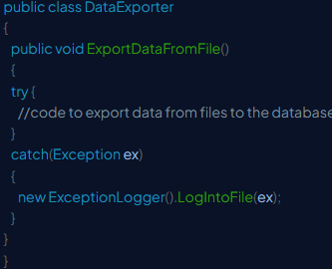

Slide 68
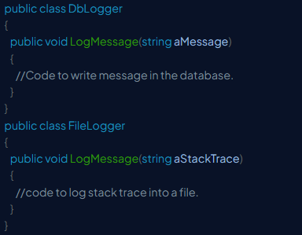

Slide 69
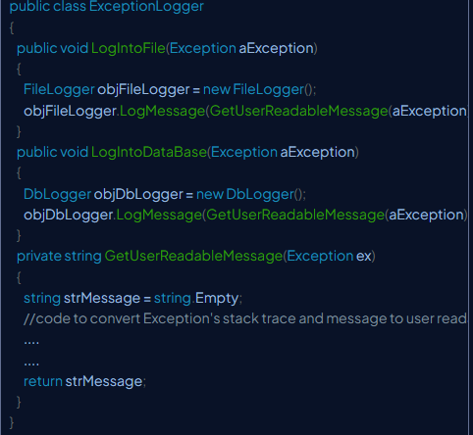
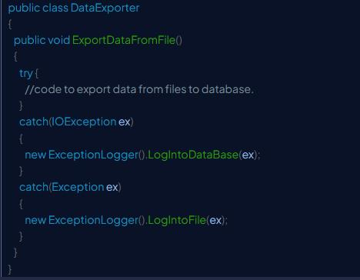

Slide 70
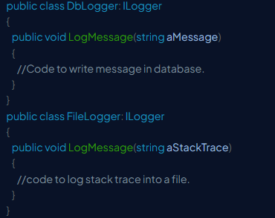
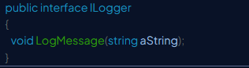

Slide 71
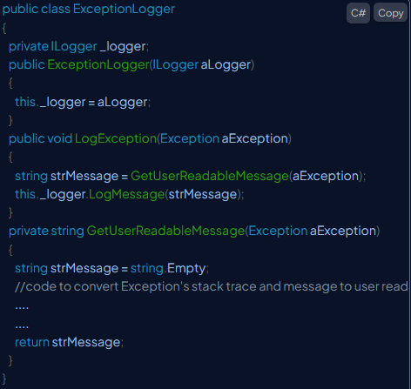

Slide 72
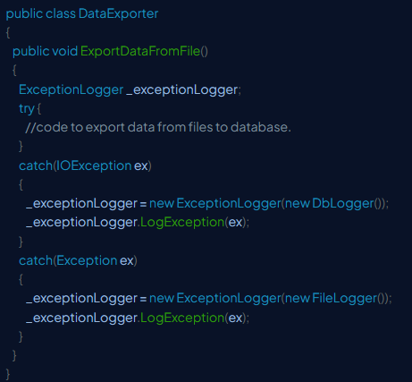

Slide 73
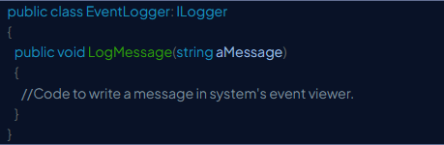

Slide 74
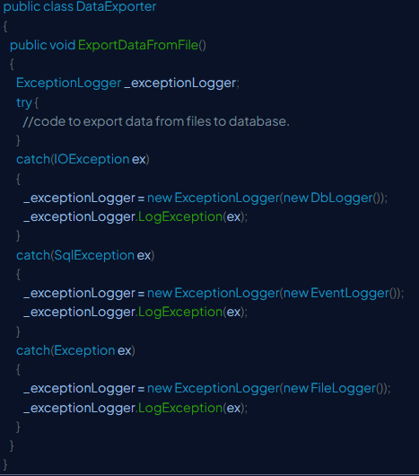

Slide 75
LAB 5

Slide 76
Notes:
https://create.kahoot.it/details/2b5d5d39-7102-4f82-88e4-75ecd6bfb771?drawer=

Slide 77
Design resilient code with interfaces
Interfaces in C#/.NET programming are essential for creating resilient and maintainable code by reducing dependencies and enabling flexible design.
In this module, you explore advanced concepts of interfaces in C#. You learn how to implement explicit interface members, combine multiple interfaces, and reduce code dependencies using interfaces.
Notes:
https://learn.microsoft.com/en-us/training/modules/design-resilient-code-interfaces/2-examine-interface-designs

Slide 78
Multiple interfaces in a class
A class in C# can implement multiple interfaces, allowing it to inherit behavior from various sources. The ability to combine multiple interfaces is crucial because C# doesn't support multiple inheritance of classes. Implementing multiple interfaces allows a class to have different features and ensures it follows the rules set by those interfaces.
Interfaces define a group of related functionalities.
A class or struct must implement all members of the interfaces it inherits.
Interfaces can contain methods, properties, events, and indexers.

Slide 79
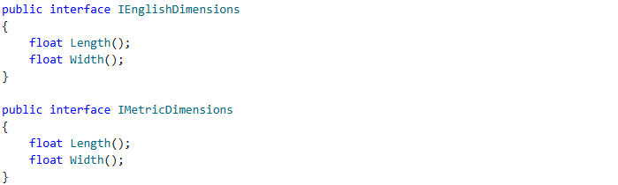

Slide 80
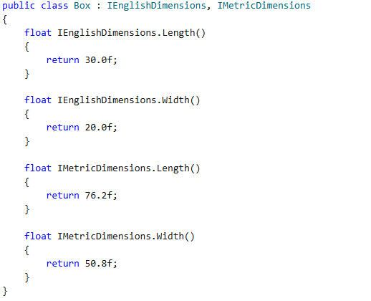

Slide 81
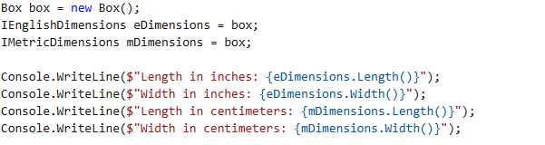

Slide 82
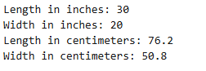

Slide 83
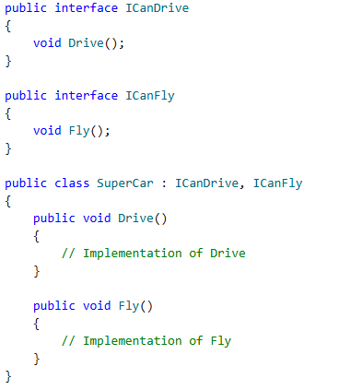

Slide 84
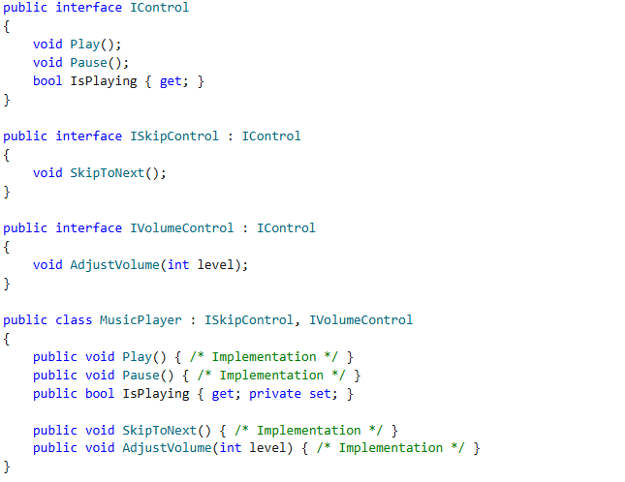

Slide 85
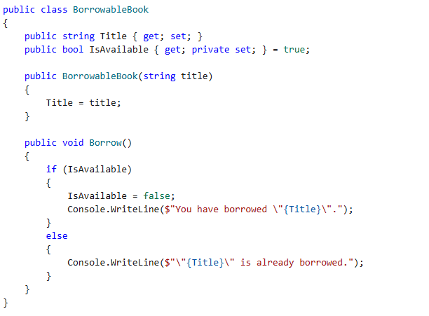
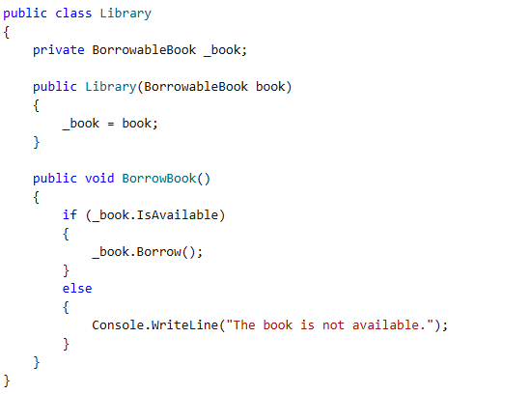

Slide 86
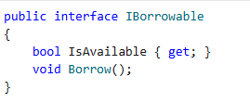

Slide 87
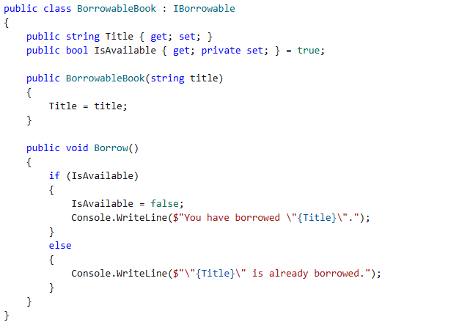

Slide 88
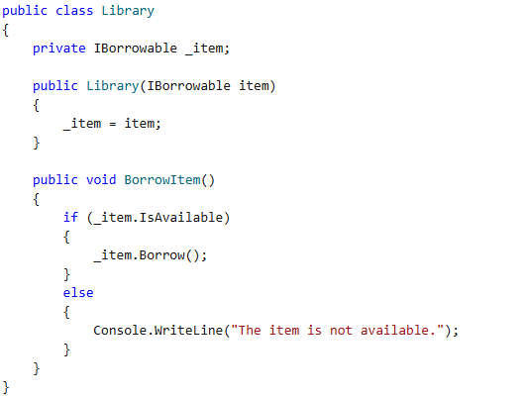

Slide 89
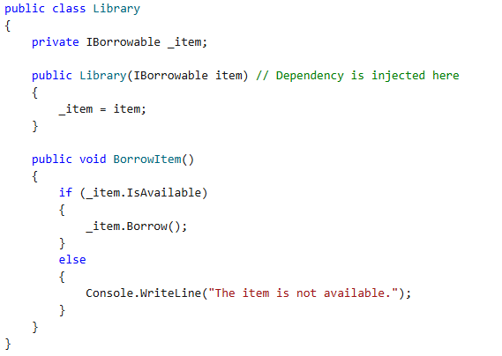

Slide 90


Slide 91


Slide 92
LAB 6

Slide 93
Notes:
https://create.kahoot.it/share/c-generics-linq-and-solid/c574ef7e-3656-4e0a-9d29-e52f9c9c162e

Slide 94
Exploring concurrency, parallelism and asynchronous programming
Concurrency is the ability of a system to manage multiple tasks at the same time, although not necessarily simultaneously. It executes tasks in a way that makes progress on several tasks without waiting for one to complete before starting another. Imagine you are juggling multiple balls, giving each one a little attention — this is concurrency.
Notes:
https://medium.com/@it.illuminated/exploring-concurrency-parallelism-and-asynchronous-programming-in-ne-29e0fce8cf20

Slide 95
Exploring concurrency, parallelism and asynchronous programming
Parallelism takes concurrency a step further by executing multiple tasks simultaneously, typically on multiple CPU cores. This allows multitasking, where different parts of a program run at the same time. It’s like having multiple jugglers, each handling their own set of balls at the same time.

Slide 96
Exploring concurrency, parallelism and asynchronous programming
Asynchronous Programming allows tasks to run independently of the main program flow, keeping applications responsive even while waiting for long-running operations to complete. This is important for tasks like fetching data from a server or reading files, which can take time. It’s like setting an alarm clock to ring when a task is done, while you move on to other things. When the alarm rings, you come back to it — this is asynchronous programming.

Slide 97
Threads and Tasks
Task.Run(() => { Thread.Sleep(1000); Console.WriteLine("Task completed!"); });

Slide 98
Asynchronous programming
public async Task<string> FetchDataAsync() { using (HttpClient client = new HttpClient()) { string data = await client.GetStringAsync("https://example.com"); return data; } }

Slide 99
Impact on OS and hardware
The OS scheduler manage the execution of threads. It decides which threads run on which CPU cores and for how long, balancing different factors to optimize system performance. The scheduler uses algorithms like round-robin, priority-based scheduling or multilevel queue scheduling to allocate CPU time to threads. This allows fair resource allocation and reducing context switching overhead. When the scheduler switches from one thread to another, it performs a context switch, saving the state of the current thread and loading the state of the next one. The scheduler distributes threads across CPU cores to balance the load, preventing some cores from being overloaded while others are underutilized.

Slide 100
Parallelism and the power of modern CPUs
Parallelism breaks down a task into smaller sub-tasks that can be processed simultaneously, using multiple CPU cores to improve performance. Modern CPUs come with multiple cores and support simultaneous multithreading (SMT) technologies, such as Intel’s Hyper-Threading.
Parallel.For(0, 100, i => { ProcessItem(i); });

Slide 101
public async Task ProcessDataAsync(List<int> data) { var tasks = data.Select(item => Task.Run(() => ProcessItem(item))).ToArray(); await Task.WhenAll(tasks); }

Slide 102
Race conditions
Thread A reads counter (value = 0)
Thread B reads counter (value = 0)
Thread A increments counter (value = 1)
Thread B increments counter (value = 1)
Both threads write back their values, resulting in counter being 1 instead of the expected 2.

Slide 103
int counter = 0; Parallel.For(0, 1000, i => { counter++; // Potential race condition });

Slide 104

Multiprogramming
Notes:
https://www.codemag.com/Article/2411071/Threads-Asynchrony-Parallelism-and-Concurrency-in-C

Slide 105

Multithreading

Slide 106

Multitasking

Slide 107

Multiprocessing

Slide 108

Creating a Thread

Slide 109


Slide 110


Slide 111


Slide 112

Putting a Thread to Sleep in C#

Slide 113


Slide 114

Setting Thread Priority

Slide 115

Retrieving the State of a Thread

Slide 116
Suspending and Resuming a Thread
In C#, a thread can be suspended or resumed using the deprecated methods Suspend and Resume. These methods are deprecated and their use is discouraged in .NET Framework and .NET Core. This is because if you suspend a thread that's already inside a critical section where it's holding a lock on a critical resource, the entire application might deadlock. A better way to handle this is by using WaitHandle.

Slide 117

Terminating a Thread

Slide 118

Deadlock

Slide 119


Slide 120


Slide 121

Asynchronous Programming

Slide 122


Slide 123
The async and await Keywords
The async keyword converts a method into an asynchronous one enabling the use of the await keyword inside the method body. Note that Task and Task<T>v are two awaitable types provided by .NET Core. An async method returns a Task or Task<T> object and performs non-blocking operations. You must use the await keyword to call an async method.

Slide 124
Parallelism
In computing, parallelism is defined as the capability of an operating system to accomplish multiple tasks concurrently by leveraging multiple processors or cores. You can take advantage of parallelism to increase the overall performance and responsiveness of your applications that process large amounts of data or handle computationally intensive tasks.

Slide 125
Why Parallelism Is Important
By leveraging all the of the CPUs present in multi-core PCs, and high-performance computing clusters (HPS clusters), parallel programming becomes inevitable when handling problems that involve massive computations. In parallel programming, you decompose a problem into smaller workable steps that can be executed concurrently. In parallel programming, the tasks are parallelized during their execution so that they can run simultaneously on different cores within a CPU. Parallel programming is useful where there is massive amount of data and application performance is crucial.

Slide 126
Parallel Programming
Here are the key use cases of parallel programming:
Climate research
Applied physics
Quantum mechanics
Advanced graphics
Modular modeling

Slide 127
Task Parallel Library (TPL)
The Task Parallel Library (TPL) encompasses a collection of APIs pertaining to the System.Threading and System.Threading.Tasks namespaces that are used to implement parallelism and concurrency. It provides an abstraction over lower-level constructs like threads, synchronization primitives, etc., allowing you to write more scalable code without having to deal with these low-level details directly.

Slide 128

Get started with asynchronous programming
Notes:
https://learn.microsoft.com/es-es/training/modules/implement-asynchronous-tasks/

Slide 129
Implement asynchronous file input and output
The async and await keywords in C# allow you to create asynchronous methods that can perform file I/O operations without blocking the main thread. This is particularly useful in applications with a user interface, where blocking the main thread can lead to a frozen or unresponsive UI. The System.IO and System.Text.Json namespaces provide classes and methods for performing file I/O operations asynchronously.
For example, the File class in the System.IO namespace provides methods for reading and writing files asynchronously. The File.ReadAllTextAsync method reads the contents of a file asynchronously, while the File.WriteAllTextAsync method writes text to a file asynchronously. These methods return a Task<string> or Task that represents the asynchronous operation, allowing you to use the await keyword to wait for their completion without blocking the calling thread.

Slide 130
Access web resources asynchronously
The HttpClient class is part of the System.Net.Http namespace, which provides classes for sending HTTP requests and receiving HTTP responses. The HttpClient class is designed to be used asynchronously, allowing you to make nonblocking calls to web resources.
The HTTPClient class includes the following asynchronous methods:
GetAsync: Sends a GET request to the specified URI and returns the response.
PostAsync: Sends a POST request to the specified URI with the specified content and returns the response.
PutAsync: Sends a PUT request to the specified URI with the specified content and returns the response.
DeleteAsync: Sends a DELETE request to the specified URI and returns the response.
SendAsync: Sends an HTTP request message and returns the response.

Slide 131
Data parallelism
Data parallelism is a form of parallel programming that focuses on performing the same operation on multiple data elements simultaneously. This is particularly useful when you have large datasets and want to perform computations or transformations on each element independently. In C#, you can use the Parallel.For and Parallel.ForEach methods to achieve data parallelism easily. These methods allow you to iterate over collections or ranges of data in parallel, distributing the workload across multiple threads.
The Task Parallel Library supports data parallelism through the System.Threading.Tasks.Parallel class. This class provides method-based parallel implementations of for and foreach loops. You write the loop logic for a Parallel.For or Parallel.ForEach loop much as you would write a sequential loop. The TPL handles all the low-level work for you.

Slide 132
LAB 7

Slide 133

Notes:
Luego hablare del dibujo de la diapo diciendo las diferentes herramientas
DevOps es un marco de trabajo y una filosofía en constante evolución que promueve un mejor desarrollo de aplicaciones en menos tiempo y la rápida publicación de nuevas o revisadas funciones de software o productos para los clientes.
Con DevOps se promueve una comunicación continua más fluida, la colaboración, la integración, la visibilidad y la transparencia entre equipos de desarrollo de aplicaciones (Dev) y sus homólogos en operaciones tecnológicas (Ops).
Esta relación estrecha entre «Dev» y «Ops» se extiende a cada una de las fases del ciclo de vida de DevOps: desde la planificación inicial del software a las fases de codificación, compilación, pruebas y publicación, y en la puesta en marcha, las operaciones y la supervisión continua. Esta relación impulsa un bucle de retroalimentación continua con los clientes sobre las mejoras, el desarrollo, las pruebas y la puesta en marcha. Uno de los resultados de todos estos esfuerzos puede ser la publicación continua y más rápida de las adiciones y los cambios que se necesitan en las funciones.
Algunas personas agrupan los objetivos de DevOps en cuatro categorías: cultura, automatización, medición y uso compartido (CAMS, por sus siglas en inglés), y las herramientas de DevOps pueden ayudar en estas tareas. Con estas herramientas, los flujos de trabajo de desarrollo y operaciones se convierten en tareas más optimizadas y colaborativas al automatizar tareas que antes eran manuales, estáticas o que llevaban mucho tiempo, y que son necesarias para la integración, el desarrollo, las pruebas, la puesta en marcha o la supervisión.
Los seguidores de las prácticas de DevOps a menudo incorporan a su «cadena de herramientas» de DevOps particular algunas herramientas que se adaptan perfectamente a estos métodos. El objetivo de estas herramientas es tratar de optimizar, acortar y automatizar las diversas etapas del flujo de trabajo de creación de software (o «canalización»). Muchas de estas herramientas también promueven los postulados principales de DevOps, como son la automatización, la colaboración y la integración entre los equipos de desarrollo y operaciones.
Por qué es tan importante DevOps
Además de los esfuerzos por romper las barreras de comunicación y fomentar la colaboración entre los equipos de desarrollo y operaciones tecnológicas, uno de los principales valores de DevOps es lograr la satisfacción del cliente y prestar sus servicios en menos tiempo. DevOps también se ha creado para impulsar la innovación empresarial y ser el motor de continuas mejoras en los procesos.
La práctica de DevOps propicia que cada empresa se ponga como objetivo ofrecer un mejor servicio cada vez, en menos tiempo, de mejor calidad y con mayor seguridad a sus clientes finales; por ejemplo, con actualizaciones, funciones o versiones de producto más frecuentes. Puede reflejarse en la rapidez con la que llega al cliente una nueva versión del producto o una nueva función manteniendo los mismos niveles de calidad y seguridad, o en el poco tiempo que se necesita para identificar un problema o un error y, a continuación, solucionarlo y volver a publicar una versión corregida.
Sin duda, todo este trabajo de DevOps se sustenta en una infraestructura subyacente con un rendimiento, una disponibilidad y una fiabilidad fluida y sin interrupciones del software, el cual se desarrolla y se prueba en primer lugar y, luego, se lanza a la fase de producción.
A continuación se ofrece un ejemplo de herramientas que se emplean en las diversas etapas del ciclo de DevOps.
Planificación. En esta fase se definen los requisitos y valores empresariales. Algunas herramientas de muestra son Jira o Git, con las cuales se puede hacer un seguimiento de los problemas conocidos y llevar a cabo la gestión de los proyectos.
Codificación. Esta fase implica el diseño del software y la creación del código. Algunas herramientas de muestra son GitHub, GitLab, Bitbucket o Stash.
Compilación. En esta fase se gestionan las versiones y las compilaciones del software, y se utilizan herramientas automatizadas que ayudan a compilar y crear paquetes de código para publicarlos después para la producción. Se utilizan repositorios de código fuente o repositorios de paquetes que también «empaquetan» la infraestructura que se necesita para el lanzamiento del producto. Algunas herramientas de muestra son Docker, Ansible, Puppet, Chef, Gradle, Maven o JFrog Artifactory.
Prueba. Esta fase incluye la realización de pruebas continuas (manuales o automatizadas) para garantizar la calidad de la programación. Algunas herramientas de muestra son JUnit, Codeception, Selenium, Vagrant, TestNG o BlazeMeter
Puesta en marcha. En esta fase se emplean herramientas que ayudan a gestionar, coordinar, programar y automatizar las tareas de producción de las versiones de productos. Algunas herramientas de muestra son Puppet, Chef, Ansible, Jenkins, Kubernetes, OpenShift, OpenStack, Docker o Jira.
Funcionamiento. En esta fase se gestiona el software durante su producción. Algunas herramientas de muestra son Ansible, Puppet, PowerShell, Chef, Salt o Otter.
Supervisión. En esta fase se identifica y recopila información sobre problemas que surgen en una versión de software específica que se encuentra en producción. Algunas herramientas de muestra son New Relic, Datadog, Grafana, Wireshark, Splunk, Nagios o Slack.

Slide 134

CI
Notes:
La integración continua es una práctica de desarrollo de software mediante la cual los desarrolladores combinan los cambios en el código en un repositorio central de forma periódica, tras lo cual se ejecutan versiones y pruebas automáticas. La integración continua se refiere en su mayoría a la fase de creación o integración del proceso de publicación de software y conlleva un componente de automatización (p. ej., CI o servicio de versiones) y un componente cultural (p. ej., aprender a integrar con frecuencia). Los objetivos clave de la integración continua consisten en encontrar y arreglar errores con mayor rapidez, mejorar la calidad del software y reducir el tiempo que se tarda en validar y publicar nuevas actualizaciones de software.
¿Por qué es necesaria la integración continua?
Anteriormente, era común que los desarrolladores de un equipo trabajasen aislados durante un largo periodo de tiempo y solo intentasen combinar los cambios en la versión maestra una vez que habían completado el trabajo. Como consecuencia, la combinación de los cambios en el código resultaba difícil y ardua, además de dar lugar a la acumulación de errores durante mucho tiempo que no se corregían. Estos factores hacían que resultase más difícil proporcionar las actualizaciones a los clientes con rapidez.
¿En qué consiste la integración continua?
Con la integración continua, los desarrolladores envían los cambios de forma periódica a un repositorio compartido con un sistema de control de versiones como Git. Antes de cada envío, los desarrolladores pueden elegir ejecutar pruebas de unidad local en el código como medida de verificación adicional antes de la integración. Un servicio de integración continua crea y ejecuta automáticamente pruebas de unidad en los nuevos cambios realizados en el código para identificar inmediatamente cualquier error.
La integración continua se refiere a la fase de creación y pruebas de unidad del proceso de publicación de software. Cada revisión enviada activa automáticamente la creación y las pruebas.
Con la entrega continua, se crean, prueban y preparan automáticamente los cambios en el código y se entregan para la fase de producción. La entrega continua amplía la integración continua al implementar todos los cambios en el código en un entorno de pruebas y/o de producción después de la fase de creación.

Slide 135

CD
Notes:
La Entrega Continua (Continuous Delivery en inglés) es una práctica clave en DevOps que tiene como objetivo principal asegurar que el software se pueda entregar de forma rápida, confiable y sostenible a través de procesos de desarrollo altamente automatizados y eficientes. Se enfoca en llevar los artefactos de software (aplicaciones, servicios, etc.) a un estado donde puedan ser liberados en cualquier momento.
Aquí te explico los conceptos clave de la Entrega Continua:
1. **Automatización:**
La Entrega Continua se basa en la automatización de todo el proceso de construcción, prueba e implementación del software. Esto significa que cada paso, desde la compilación del código hasta la ejecución de pruebas y la liberación, se realiza de forma automática utilizando herramientas específicas.
2. **Integración Continua:**
La Integración Continua es un componente fundamental de la Entrega Continua. Implica la integración frecuente del código en un repositorio compartido, donde se realizan pruebas y verificaciones automáticas para garantizar que las nuevas contribuciones no rompan el sistema existente.
3. **Despliegue Automatizado:**
La Entrega Continua implica que el proceso de despliegue en los distintos entornos (desarrollo, pruebas, preproducción, producción) está completamente automatizado. Esto permite que las nuevas versiones del software se implementen en estos entornos de manera eficiente y sin errores manuales.
4. **Pruebas Automatizadas:**
Se utilizan pruebas automáticas en cada etapa del proceso de desarrollo y entrega para garantizar la calidad del software. Estas pruebas incluyen pruebas unitarias, pruebas de integración, pruebas de sistema y cualquier otro tipo de prueba que se considere relevante para la aplicación.
5. **Liberación Bajo Demanda:**
La Entrega Continua permite que se pueda liberar software en cualquier momento con solo presionar un botón. Esto proporciona flexibilidad y rapidez en la respuesta a las necesidades del negocio o a las oportunidades del mercado.
6. **Feedback Rápido:**
Al permitir la entrega rápida y frecuente de software, la Entrega Continua facilita la obtención de feedback rápidamente sobre las nuevas funcionalidades y correcciones. Esto permite realizar ajustes rápidos y continuos para mejorar la calidad y la satisfacción del cliente.
En resumen, la Entrega Continua busca eliminar las barreras entre los equipos de desarrollo y operaciones al permitir una entrega más rápida y confiable de software. Esto no solo mejora la eficiencia y la calidad, sino que también facilita la adaptación ágil a los cambios y la satisfacción constante de las necesidades de los usuarios finales.
La entrega continua es una práctica de desarrollo de software mediante la cual se preparan automáticamente los cambios en el código y se entregan a la fase de producción. Fundamental para el desarrollo de aplicaciones modernas, la entrega continua amplia la integración continua al implementar todos los cambios en el código en un entorno de pruebas o de producción después de la fase de compilación. Cuando la entrega continua se implementa de manera adecuada, los desarrolladores dispondrán siempre de un artefacto listo para su implementación que se ha sometido a un proceso de pruebas estandarizado.
La entrega continua permite a los desarrolladores automatizar las pruebas más allá de las pruebas de unidades, por lo que pueden verificar actualizaciones en las aplicaciones en varias dimensiones antes de enviarlas a los clientes. Las pruebas pueden incluir pruebas de la UI, de carga, de integración, de fiabilidad de la API, etc. De este modo, los desarrolladores pueden validar las actualizaciones de forma más exhaustiva y descubrir problemas por anticipado. Con la nube, resulta sencillo y rentable automatizar la creación y replicación de varios entornos de pruebas, algo que anteriormente era complicado en las instalaciones.
Entrega continua e implementación continua
Con la entrega continua, todos los cambios en el código se crean, se prueban y se envían a un entorno de almacenamiento o pruebas de no producción. Pueden efectuarse varias pruebas al mismo tiempo antes de la implementación en producción. La diferencia entre la entrega continua y la implementación continua es la diferencia de aprobación manual para actualizar la producción. Con la implementación continua, la producción tiene lugar de manera automática, sin aprobación explícita.

Slide 136

Notes:
A continuación se ofrece un ejemplo de herramientas que se emplean en las diversas etapas del ciclo de DevOps.
Planificación. En esta fase se definen los requisitos y valores empresariales. Algunas herramientas de muestra son Jira o Git, con las cuales se puede hacer un seguimiento de los problemas conocidos y llevar a cabo la gestión de los proyectos.
Codificación. Esta fase implica el diseño del software y la creación del código. Algunas herramientas de muestra son GitHub, GitLab, Bitbucket o Stash.
Compilación. En esta fase se gestionan las versiones y las compilaciones del software, y se utilizan herramientas automatizadas que ayudan a compilar y crear paquetes de código para publicarlos después para la producción. Se utilizan repositorios de código fuente o repositorios de paquetes que también «empaquetan» la infraestructura que se necesita para el lanzamiento del producto. Algunas herramientas de muestra son Docker, Ansible, Puppet, Chef, Gradle, Maven o JFrog Artifactory.
Prueba. Esta fase incluye la realización de pruebas continuas (manuales o automatizadas) para garantizar la calidad de la programación. Algunas herramientas de muestra son JUnit, Codeception, Selenium, Vagrant, TestNG o BlazeMeter.
Puesta en marcha. En esta fase se emplean herramientas que ayudan a gestionar, coordinar, programar y automatizar las tareas de producción de las versiones de productos. Algunas herramientas de muestra son Puppet, Chef, Ansible, Jenkins, Kubernetes, OpenShift, OpenStack, Docker o Jira.
Funcionamiento. En esta fase se gestiona el software durante su producción. Algunas herramientas de muestra son Ansible, Puppet, PowerShell, Chef, Salt o Otter.
Supervisión. En esta fase se identifica y recopila información sobre problemas que surgen en una versión de software específica que se encuentra en producción. Algunas herramientas de muestra son New Relic, Datadog, Grafana, Wireshark, Splunk, Nagios o Slack.

Slide 137

Notes:
¿QUE ES LA CALIDAD DEL SOFTWARE?
La calidad del software es el conjunto de cualidades que lo caracterizan y que determinan su utilidad y existencia. La calidad es sinónimo de eficiencia, flexibilidad, corrección, confiabilidad, mantenibilidad, portabilidad, usabilidad, seguridad e integridad.La calidad del software es medible y varía de un sistema a otro o de un programa a otro. Un software elaborado para el control de naves espaciales debe ser confiable al nivel de "cero fallas"; un software hecho para ejecutarse una sola vez no requiere el mismo nivel de calidad; mientras que un producto de software para ser explotado durante un largo período (10 años o más), necesita ser confiable, mantenible y flexible para disminuir los costos de mantenimiento y perfeccionamiento durante el tiempo de explotación.
La calidad del software puede medirse después de elaborado el producto. Pero esto puede resultar muy costoso si se detectan problemas deriva dos de imperfecciones en el diseño, por lo que es imprescindible tener en cuenta tanto la obtención de la calidad como su control durante todas las etapas del ciclo de vida del software.
¿COMO OBTENER UN SOFTWARE DE CALIDAD?
La obtención de un software con calidad implica la utilización de metodologías o procedimientos estándares para el análisis, diseño, programación y prueba del software que permitan uniformar la filosofía de trabajo, en aras de lograr una mayor confiabilidad, mantenibilidad y facilidad de prueba, a la vez que eleven la productividad, tanto para la labor de desarrollo como para el control de la calidad del software.La política establecida debe estar sustentada sobre tres principios básicos: tecnológico, administrativo y ergonómico.
El principio tecnológico define las técnicas a utilizar en el proceso de desarrollo del software.
El principio administrativo contempla las funciones de planificación y control del desarrollo del software, así como la organización del ambiente o centro de ingeniería de software.
El principio ergonómico define la interfaz entre el usuario y el ambiente automatizado.
La adopción de una buena política contribuye en gran medida a lograr la calidad del software, pero no la asegura. Para el aseguramiento de la calidad es necesario su control o evaluación.
8 características principales de calidad de software
Las 8 principales características de calidad del software son:
Idoneidad funcional. El grado o nivel en que el software resultante proporciona funciones que satisfacen las necesidades establecidas para determinadas condiciones.
Fiabilidad. El grado en que un sistema o componente software realiza sus funciones bajo determinadas condiciones y período de tiempo.
Eficiencia en el desempeño. El rendimiento en relación con la cantidad de recursos utilizados en las condiciones establecidas.
Usabilidad. El grado o nivel en que el software permite ser entendido, aprendido, usado y fácil para el usuario.
Seguridad. El grado de protección de la información y los datos para que las personas o los sistemas no autorizados no puedan leerlos o modificarlos y que permita el acceso y uso a las personas o sistemas autorizados.
Compatibilidad. El grado en que dos o más sistemas o componentes pueden intercambiar información y/o realizar sus funciones.
Mantenibilidad. El grado de eficacia y eficiencia con que el software puede ser. Modificado y/o actualizado.
Transferibilidad. El grado o nivel en que un sistema o componente transferido de un hardware, software u otro entorno operativo a otro.
Esta norma ISO 25010 es eficaz para determinar la calidad en una etapa temprana de desarrollo software.
Limitaciones y ventajas de la norma ISO 25010
Esta gran norma tiene algunas limitaciones:
La norma no especifica cómo se han de medir las características de calidad.
Algunas de las características de calidad parecen subjetivas.
Aunque existe un estándar ISO 25023 que define métricas para medir la ISO 25010, tiene una limitación, y es que la mayoría de estas métricas están a nivel de comportamiento y no a nivel de código de software.
La otra normativa que nos permite definir métricas de medida la ISO 5055, está limitada a solo 4 de las 8 características de calidad de la ISO 25010.
Otra de las limitaciones es que la mayoría de las características de calidad definidas tienen diferentes significados en diferentes contextos, como velocidad de ejecución que en un contexto web puede ser válido pero que en un contexto de necesidades de tiempo real no lo sería.
A pesar de estas limitaciones podemos decir que la normativa nos permite medir las más significativas y que el sector ha reconocido que son las siguientes:
Cobertura del código
Interpretación abstracta
Complejidad ciclomática
Advertencias del compilador
Normas de codificación
Duplicación de código
Despliegue
Seguridad
La ventaja de medir es que nos permite saber si nuestro código ha sido bien desarrollado. Por tanto las normativas ayudan a generar buen código, pero no son suficientes.

Slide 138

TESTS
Types of tests
Unit tests
Integration tests
Acceptance tests
Performance tests
Notes:
Pruebas de unidad: son pruebas realizadas en componentes de software individuales para verificar que funcionen correctamente de manera aislada. Estas pruebas se realizan generalmente por los desarrolladores y se centran en validar el comportamiento de las funciones, procedimientos o métodos de manera aislada, utilizando técnicas como el mockeo o el stubbing de objetos para simular el comportamiento de otros componentes. El objetivo principal de las pruebas unitarias es detectar y corregir errores en el código antes de integrarlo en el sistema.
Pruebas de integración: son pruebas realizadas para verificar que los componentes de software interactúen correctamente y produzcan el resultado esperado cuando se combinan. Estas pruebas se realizan después de las pruebas unitarias y se centran en la interacción entre los diferentes módulos o componentes del software. El objetivo principal de las pruebas de integración es detectar y corregir errores de interacción entre componentes.
Pruebas de aceptación: son pruebas realizadas para verificar que el software cumpla con los requisitos del usuario y sea adecuado para su uso. Estas pruebas se realizan después de las pruebas de integración y se centran en validar la funcionalidad del software en un entorno de usuario real. El objetivo principal de las pruebas de aceptación es asegurarse de que el software satisfaga las necesidades del usuario final.
Pruebas de rendimiento: son pruebas realizadas para verificar que el software responda adecuadamente bajo diferentes condiciones de carga y esté optimizado para su uso. Estas pruebas se realizan después de las pruebas de aceptación y se centran en medir la capacidad del software para procesar grandes volúmenes de datos y usuarios simultáneos. El objetivo principal de las pruebas de rendimiento es detectar y corregir cuellos de botella en el software y asegurar que el rendimiento sea satisfactorio para el usuario final.

Slide 139

Notes:
El testing o prueba de software es un proceso crítico en el desarrollo de software, que tiene como objetivo encontrar errores, fallos y defectos en el software antes de su lanzamiento al mercado. La prueba de software puede realizarse en diferentes niveles, desde pruebas unitarias en código individual hasta pruebas de integración del sistema completo.
El testing de software es importante porque ayuda a garantizar que el software cumpla con los requisitos del cliente, sea confiable, seguro, eficiente y tenga la calidad necesaria para su uso. Las pruebas también ayudan a detectar problemas que podrían haber sido pasados por alto durante el proceso de desarrollo, lo que puede ahorrar tiempo y dinero a largo plazo.
Existen diferentes tipos de pruebas, como pruebas funcionales, pruebas de rendimiento, pruebas de seguridad, pruebas de usabilidad, entre otras. Cada tipo de prueba tiene sus propias técnicas y herramientas, y puede requerir diferentes habilidades y conocimientos para llevarla a cabo de manera efectiva.
Es importante tener en cuenta que las pruebas de software no pueden garantizar que el software sea completamente libre de errores, pero sí pueden ayudar a minimizar la cantidad de errores que se presentan. Por lo tanto, el testing debe ser una parte integral del proceso de desarrollo de software.

Slide 140

Notes:
Las pruebas de software se pueden clasificar en dos categorías principales: pruebas estáticas y pruebas dinámicas.
Las pruebas estáticas son aquellas que se realizan sin ejecutar el software. En lugar de eso, se revisa el código, la documentación o cualquier otro artefacto del software para encontrar errores o defectos. Esto puede incluir la revisión manual del código fuente, la revisión de diagramas de flujo, la revisión de casos de prueba, entre otros.
Por otro lado, las pruebas dinámicas se realizan con el software en ejecución. Estas pruebas se utilizan para validar el comportamiento del software y encontrar errores o defectos que pueden no ser evidentes en el código fuente o en la documentación. Las pruebas dinámicas pueden incluir pruebas de unidad, pruebas de integración, pruebas de sistema y pruebas de aceptación.
En resumen, las pruebas estáticas se enfocan en encontrar errores en el software antes de que se ejecute, mientras que las pruebas dinámicas se enfocan en validar el comportamiento del software mientras se está ejecutando. Ambas son importantes para garantizar la calidad del software y deben ser parte del proceso de prueba de software.

Slide 141

Notes:
Las pruebas de software también se pueden clasificar en pruebas funcionales y no funcionales.
Las pruebas funcionales se enfocan en validar que el software cumpla con los requisitos funcionales del usuario. Es decir, que el software realice las tareas que se supone que debe realizar, de acuerdo con las especificaciones de diseño y los requisitos del usuario. Estas pruebas pueden incluir la validación de la funcionalidad del software, la verificación de la precisión de los cálculos, la comprobación de la interfaz de usuario y la evaluación de la compatibilidad con diferentes plataformas.
Las pruebas no funcionales se enfocan en validar aspectos no relacionados con la funcionalidad del software. Estas pruebas pueden incluir la evaluación del rendimiento del software, la seguridad, la usabilidad, la escalabilidad y la disponibilidad. En otras palabras, las pruebas no funcionales se centran en la calidad del software en términos de cómo se desempeña, cómo se siente y cómo responde a diferentes situaciones.
Es importante tener en cuenta que tanto las pruebas funcionales como las no funcionales son igualmente importantes en el proceso de prueba de software. Aunque las pruebas funcionales se enfocan en validar la funcionalidad del software, las pruebas no funcionales son igualmente críticas para garantizar que el software tenga la calidad necesaria para su uso.
Pruebas funcionales:
Pruebas unitarias (Unit testing): Es una forma de probar una unidad o fragmento de código más pequeño que se puede aislar lógicamente en un sistema.
Pruebas de integración (Integration testing): Prueban la integración o interfaces entre componentes, interacciones con diferentes partes del sistema, como sistema de archivos y hardware, sistema operativo,o interfaces entre sistemas.
Pruebas de sistema (System testing): Se evalúa cómo los diferentes componentes de una aplicación interactúan juntos en el sistema o aplicación completa e integrada.
Pruebas de interfaz (Interface testing): Verifica la comunicación entre dos sistemas de software diferentes comprobando la autenticación de la conexión establecida.
Pruebas de regresión (Regression testing): Garantiza que una aplicación siga funcionando según lo esperado después de producirse alguna actualización, cambio o mejora de código.
Pruebas de aceptación (Beta/acceptance testing): se realiza en un producto o prototipo antes de su comercialización o entrega, para decidir si se han cumplido las especificaciones o el contrato. Se asegura de que la calidad y el diseño del producto cumplan con los requisitos en términos de funcionalidad, usabilidad, durabilidad y seguridad.
Pruebas no funcionales:
Pruebas de rendimiento (Permormance testing): Evalúa el rendimiento, la velocidad o capacidad de respuesta de la aplicación que se prueba bajo la carga de trabajo requerida.
Prueba de carga (Load testing): Prueba el comportamiento de una aplicación bajo una gran carga de trabajo.
Pruebas de estrés (Stress Testing): Las pruebas de estrés determinan la solidez del software al evaluar el funcionamiento normal en condiciones de carga extremadamente pesada, garantizando así que el software no se bloquea en situaciones críticas.
Pruebas de volumen (Volume Testing): Prueba el rendimiento del software cargando cuando procesa grandes volúmenes de datos.
Pruebas de seguridad (Security Testing): Verifican si el sistema está protegido contra ataques repentinos o deliberados de fuentes internas y externas.
Pruebas de compatibilidad (Compatibility Testing): Comprueban si la aplicación es compatible con diferentes entornos.
Pruebas de instalación (Install Testing): Verifica si un software funciona según las expectativas después de la instalación.
Pruebas de recuperación (Recovery Testing): Determina si un sistema puede recuperarse de fallas o no.
Pruebas de confiabilidad (Reliability Testing): Garantiza que el software funciona de manera consistente realizando una tarea sin fallar dentro un período específico.
Pruebas de usabilidad (Usability Testing): Testean la facilidad de uso del usuario en términos de operación, aprendizaje y preparación de entradas y salidas.
Pruebas de conformidad (Compliance Testing): Determina si un programa o sistema de software cumple con un conjunto definido de estándares internos o externos antes de su lanzamiento a producción.

Slide 142

TIPOS DE PRUEBAS
Notes:
Los test de caja negra y de caja blanca son dos enfoques diferentes para la realización de pruebas de software.
El test de caja negra se enfoca en probar el software sin tener en cuenta su estructura interna o su código fuente. En este enfoque, el tester se enfoca en la funcionalidad del software y realiza pruebas para validar que el software cumple con los requisitos del usuario y que funciona como se espera. El tester no tiene acceso al código fuente ni a la estructura interna del software, y se enfoca en la entrada y la salida del sistema.
Por otro lado, el test de caja blanca se enfoca en probar el software conociendo su estructura interna y su código fuente. En este enfoque, el tester se enfoca en la estructura interna del software y realiza pruebas para validar que el código fuente es correcto, eficiente y cumple con los estándares de codificación. El tester tiene acceso al código fuente y a la estructura interna del software y se enfoca en la lógica del programa, las variables, los bucles y las condiciones.
Es importante destacar que tanto el test de caja negra como el de caja blanca son importantes y deben ser considerados en el proceso de prueba de software. El test de caja negra se enfoca en la funcionalidad del software, mientras que el test de caja blanca se enfoca en la calidad del código fuente y la estructura interna del software. Dependiendo del tipo de software y el objetivo de las pruebas, se puede utilizar una combinación de ambos enfoques para garantizar que el software tenga la calidad necesaria para su uso.
El test de caja gris es un enfoque de prueba que combina elementos del test de caja negra y de caja blanca. En este enfoque, el tester tiene acceso a algunas partes del código fuente y de la estructura interna del software, pero no a todo. Es decir, el tester tiene un conocimiento parcial de la estructura interna del software.
El objetivo del test de caja gris es realizar pruebas que permitan validar tanto la funcionalidad del software como su calidad interna. El tester utiliza su conocimiento parcial de la estructura interna del software para identificar las áreas que deben ser sometidas a pruebas más exhaustivas y se enfoca en validar la lógica del programa, las variables, los bucles y las condiciones.
El test de caja gris es útil cuando se necesita realizar pruebas más exhaustivas que el test de caja negra, pero sin la necesidad de un conocimiento completo del código fuente y de la estructura interna del software. Este enfoque puede ser especialmente útil en situaciones en las que se necesita validar la calidad interna del software, pero se dispone de un tiempo limitado para realizar pruebas exhaustivas.
Es importante tener en cuenta que el test de caja gris puede requerir un conocimiento técnico más avanzado que el test de caja negra y puede ser más complejo de realizar que el test de caja blanca.
La mejor manera de entender algo es con ejemplos del mundo real para poder relacionar el concepto tecnológico con algo que conocemos.
caja negra testing sería el cual una persona haría antes de comprar un coche, encender las luces, encender el motor entre otras pruebas (Sin necesidad de saber cómo funciona el coche por dentro)
realizar pruebas de tipo caja blanca sería la técnica que usa un mecánico cuando llevas tu coche al mecánico y tiene que buscar una avería.

Slide 143

AGILE TESTING
Notes:
El Agile Testing es una práctica de prueba de software que se enfoca en integrar las pruebas en el proceso de desarrollo ágil. El enfoque Agile Testing se basa en los principios del desarrollo ágil de software, como la colaboración entre los miembros del equipo, la entrega continua, la retroalimentación constante y la adaptación al cambio.
En el proceso de desarrollo ágil, el testing se realiza de manera constante durante todo el ciclo de vida del software, en lugar de esperar hasta el final del ciclo de vida para realizar pruebas. Los testers trabajan en estrecha colaboración con los desarrolladores, analistas de negocios y otros miembros del equipo para asegurar que las pruebas se realicen en el momento adecuado y se adapten a los cambios en los requisitos del usuario.
El Agile Testing se enfoca en la entrega continua y en la identificación temprana de errores, lo que permite que el equipo pueda adaptarse rápidamente a los cambios y entregar software de alta calidad en un corto período de tiempo. Además, el Agile Testing también se enfoca en la automatización de pruebas, lo que permite una mayor eficiencia y rapidez en el proceso de pruebas.
En resumen, el Agile Testing es un enfoque de prueba de software que se enfoca en la integración de pruebas en el proceso de desarrollo ágil, con el objetivo de entregar software de alta calidad de manera rápida y eficiente.

Slide 144

AUTOMATIZACIÓN DE LAS PRUEBAS
Notes:
La automatización de pruebas es un proceso en el que se utilizan herramientas de software para ejecutar pruebas de forma automatizada en lugar de realizarlas manualmente. Esto implica la creación de scripts de prueba que simulan la interacción de un usuario con el software y validan su comportamiento frente a diferentes escenarios.
La automatización de pruebas tiene varios beneficios, entre ellos:
- Aumenta la eficiencia: Al automatizar las pruebas, se pueden realizar una gran cantidad de pruebas en un período corto de tiempo y con mayor precisión que si se realizaran manualmente.
- Reducción de costos: A largo plazo, la automatización de pruebas puede resultar más económica que las pruebas manuales, ya que no se necesitan recursos humanos para realizar pruebas repetitivas y rutinarias.
- Mejora la calidad: La automatización de pruebas reduce el riesgo de errores humanos y aumenta la precisión en la ejecución de las pruebas.
- Identificación temprana de errores: La automatización de pruebas permite la identificación temprana de errores, lo que reduce el costo y el tiempo necesarios para su corrección.
Sin embargo, es importante destacar que la automatización de pruebas no es adecuada para todas las situaciones. Las pruebas manuales pueden ser más apropiadas para las pruebas exploratorias o para pruebas en las que la funcionalidad aún está en desarrollo. Además, la automatización de pruebas requiere una inversión inicial significativa en términos de tiempo y recursos para desarrollar los scripts de prueba, lo que puede no ser rentable para aplicaciones pequeñas o con un ciclo de vida corto.
En resumen, la automatización de pruebas es una práctica útil para mejorar la eficiencia, reducir costos, mejorar la calidad y detectar errores tempranamente. Sin embargo, es importante evaluar cuidadosamente su conveniencia y rentabilidad para cada situación en particular.
¡Perfecto! Estás preguntando sobre identificación de casos adecuados para automatización en testing con Java. Vamos a desglosarlo paso a paso para que quede claro y puedas aplicarlo de forma práctica.
1. Qué buscar en un caso para automatizar
No todos los casos de prueba son buenos candidatos para automatización. Los siguientes criterios te ayudan a identificar los más adecuados:
a) Repetitividad
Casos que se ejecutan con frecuencia.
Ejemplo: pruebas de login, registro, o flujos críticos en cada build.
Justificación: Automatizar ahorra tiempo y esfuerzo manual.
b) Estabilidad
Casos que no cambian con frecuencia.
Evitar automatizar funcionalidades en desarrollo activo o con requisitos inestables.
Ejemplo: validación de cálculo de impuestos según reglas establecidas.
c) Complejidad / propensión a errores
Pruebas complejas, largas o con muchos pasos.
Ejemplo: escenarios con múltiples inputs y validaciones.
Justificación: la automatización reduce errores humanos.
d) Datos abundantes / escenarios múltiples
Casos que requieren probar con muchas combinaciones de datos.
Ejemplo: formularios con distintos tipos de usuario o configuraciones de producto.
Justificación: el testing manual sería muy laborioso.
e) Críticos para el negocio
Funcionalidades centrales que no deben fallar.
Ejemplo: pagos, checkout, generación de reportes financieros.
Justificación: detectar fallos rápido es crucial.
f) Integración continua / regresión
Pruebas que deben ejecutarse en cada build o release.
Ejemplo: suites de regresión, smoke tests.
Justificación: ayuda a mantener la estabilidad de la aplicación.
2. Casos que no conviene automatizar
Pruebas exploratorias.
Interfaces muy cambiantes (UI inestable).
Validaciones visuales complejas que dependen de percepción humana (a menos que uses herramientas de visual testing avanzadas).
Casos que se ejecutan muy pocas veces.
3. Herramientas Java para automatización
Dependiendo del tipo de prueba:
Tipo de prueba Herramientas populares en Java Unit Testing JUnit, TestNG UI Web Selenium WebDriver, Selenide API / Servicios RestAssured, HTTPClient Mocking / Dependencias Mockito, WireMock Integración continua Jenkins, GitHub Actions
4. Buenas prácticas
Priorizar automatización de regresión y flujos críticos.
Mantener el código de tests limpio y modular.
Evitar dependencias entre pruebas (tests independientes).
Integrar los tests automatizados en CI/CD para ejecución frecuente.
Si quieres, puedo hacerte un ejemplo concreto de cómo seleccionar casos de prueba para automatizar en Java usando JUnit y Selenium, mostrando paso a paso cómo decidir qué automatizar primero. Esto te daría un plan práctico listo para tu proyecto.
¿Quieres que haga eso?

Slide 145

Notes:
Cucumber es una herramienta, escrita originalmente en Ruby, que ejecuta descripciones funcionales en texto plano como test automáticos, aprovechando las ventajas del BDD como puede ser acercar la capa de negocio y tecnología de una empresa, permitiendo que no solo se desarrollen bien las funcionalidades, sino que se desarrollen las funcionalidades que mas valor van a aportar al usuario, a la vez que definimos casos de prueba y documentamos un proyecto.
La idea principal es que pueda ser entendido y usado no solo por desarrolladores sino por los clientes y gente de negocio.
El lenguaje que usa Cucumber para definir los requisitos se llama Gherkin, el cual nos permite traducir esas especificaciones en un lenguaje cercano al natural en especificaciones de test en el lenguaje que queramos, un ejemplo de Gherkin sería el siguiente:
Feature: Search courses
In order to ensure better utilization of courses
Potential students should be able to search for courses
Scenario: Search by topic
Given there are 240 courses which do not have the topic "biology"
And there are 2 courses A001, B205 that each have "biology" as one of the topics
When I search for "biology"
Then I should see the following courses:
| Course code |
| A001 |
| B205 |
3. ¿En qué consiste Gherkin?
Gherkin es el lenguaje que entiende Cucumber, es un DSL legible para gente no técnica, que permite definir el comportamiento del software sin detallar como está implementado, además de que nos permite documentar las funcionalidades a la vez que escribimos casos de prueba automáticos.
Otras ventajas que nos proporciona usar Gherkin y Cucumber son:
Fáciles de leer
Fáciles de entender
Fáciles de Parsear
Fáciles de discutir
Gherkin es un lenguaje que usa el indentado para definir la estructura, de manera que los saltos de linea dividen las diferentes declaraciones, la mayoría de las lineas empiezan con palabras clave. El parser divide el texto en Features ( Características ), Scenarios y Steps, cuando pasas los casos de prueba, el parser busca un Step con ese nombre. Los Steps son los análogos de los Métodos en Java o las Funciones en Javascript.
Gherkin está localizado en muchos idiomas entre ellos el español:
# language: es
Característica: adición
Para evitar hacer errores tontos
Como un ser humano
Quiero saber la suma de los números
Esquema del escenario: Sumar dos números
Dado que he introducido <entrada_1> en la calculadora
Y que he introducido <entrada_2> en la calculadora
Cuando oprimo el <botón>
Entonces el resultado debe ser <resultado> en la pantalla
Ejemplos:
| entrada_1 | entrada_2 | botón | resultado |
| 20 | 30 | add | 50 |
| 2 | 5 | add | 7 |
| 0 | 40 | add | 40 |
Generaría
# encoding: utf-8
begin require 'rspec/expectations'; rescue LoadError; require 'spec/expectations'; end
require 'cucumber/formatter/unicode'
$:.unshift(File.dirname(__FILE__) + '/../../lib')
require 'calculador'
Before do
@calc = Calculador.new
end
Dado /que he introducido (\d+) en la calculadora/ do |n|
@calc.push n.to_i
end
Cuando /oprimo el (\w+)/ do |op|
@result = @calc.send op
end
Entonces /el resultado debe ser (.*) en la pantalla/ do |result|
@result.should == result.to_f
end
Cada feature ( característica ) se define en un archivo, una característica normalmente consiste en una serie de escenarios, el texto entre Característica y «Esquema del escenario» permite definir libremente ya que este texto no será usado para ninguna funcionalidad de Cucumber, es meramente descriptivo.
Este código nos generará un esqueleto ( dependiendo del lenguaje en el que vayamos a producir los test y el adaptador que estemos usando ), el cual pasará los test con los distintos casos que le hayamos definido. Luego será nuestra tarea la de definir los casos de prueba que comprobarán las diferentes características.
Se pueden diferenciar claramente tres grupos que cumplen funciones distintas:
Feature: Aquí es donde indicamos el nombre de la característica a probar.
Scenario: Esta «keyword» describe los distintos escenarios que van a probar las diferentes posibilidades.
Given (Dado) : El propósito de los «Dado» es el de poner al sistema en el estado deseado para pasar los test deseados, antes de que el usuario ( o un sistema externo ), interactúe con el sistema.
When ( Cuando ) : En este caso el propósito de los «Cuando» es el describir la acción que realiza el usuario, la cual vamos a probar.
Then ( Entonces ) : El propósito de los «Entonces» es observar los resultados, estas observaciones han de ser realizadas desde el punto de vista de negocio y el valor para el usuario. Estas observaciones también deben de estar en algún sitio visible para el usuario, no en una base de datos o capas inferiores del sistema.
And, But ( Y, Pero ): Estas «keywords» están destinadas a aumentar la legibilidad y pueden ser usadas en vez de definir repetidas veces cualquiera de las anteriores.
Al ejecutar Cucumber, buscará un Step que coincida con cada definición, siendo irrelevante la «keyword» usada para otra cosa que no sea el orden, esto cambia ligeramente dependiendo el lenguaje que estemos probando.
4. Ejemplos Prácticos
Podemos encontrar ejemplos en distintos lenguajes como:
Java, mostrando el archivo desde el que se parte y el archivo que se generaría, incluyendo algún test de ejemplo ya implementado, Feature & Step.
Y Ruby Feature & Steps.

Slide 146
LAB 8

Slide 147

Notes:
https://www.frugaltesting.com/blog/a-beginners-guide-testing-with-nunit

Slide 148


Slide 149


Slide 150


Slide 151


Slide 152


Slide 153


Slide 154


Slide 155


Slide 156


Slide 157
LAB 9

Slide 158


Slide 159


Slide 160


Slide 161


Slide 162


Slide 163
EXTRA INFO
https://docs.nunit.org/2.5.3/assertions.html

Slide 164
Notes:
Duplicado de Unit Testing

Slide 165

GITHUB ACTIONS

Slide 166

Ci/cd
Notes:
CI/CD es un acrónimo que significa Continuous Integration/Continuous Delivery (Integración Continua/Entrega Continua, en español).
La Integración Continua (CI) es una práctica de desarrollo de software que consiste en integrar y verificar el código fuente en un repositorio centralizado de forma frecuente, para detectar y solucionar errores de manera temprana. Esto se logra mediante la automatización de pruebas y verificaciones cada vez que se realiza una modificación en el código.
La Entrega Continua (CD) es una práctica que consiste en automatizar todo el proceso de entrega de software desde el repositorio centralizado hasta el ambiente de producción. Esto implica una serie de pasos, como la compilación, pruebas de aceptación, despliegue y monitoreo de la aplicación.
En conjunto, CI/CD proporciona un flujo de trabajo automatizado y eficiente para el desarrollo de software, lo que permite a los equipos de desarrollo entregar nuevas funcionalidades y correcciones de manera más rápida y confiable.

Slide 167

Github actions
Notes:
GitHub Actions es una plataforma de integración y despliegue continuos (IC/DC) que te permite automatizar tu mapa de compilación, pruebas y despliegue. Puedes crear flujos de trabajo y crear y probar cada solicitud de cambios en tu repositorio o desplegar solicitudes de cambios fusionadas a producción.
GitHub Actions va más allá de solo DevOps y te permite ejecutar flujos de trabajo cuando otros eventos suceden en tu repositorio. Por ejemplo, puedes ejecutar un flujo de trabajo para que agregue automáticamente las etiquetas adecuadas cada que alguien cree una propuesta nueva en tu repositorio.
GitHub proporciona máquinas virtuales Linux, Windows y macOS para que ejecutes tus flujos de trabajo o puedes hospedar tus propios ejecutores auto-hospedados en tu propio centro de datos o infraestructura en la nube.

Slide 168

Los componentes de github actions
Notes:
Puede configurar un flujo de trabajo de GitHub Actions que se desencadene cuando se produzca un evento en el repositorio, por ejemplo, la apertura de una solicitud de incorporación de cambios o la creación de una incidencia. El flujo de trabajo contiene uno o varios trabajos que se pueden ejecutar en orden secuencial o en paralelo. Cada trabajo se ejecutará dentro de su propio ejecutor de máquina virtual o dentro de un contenedor, y tendrá uno o varios pasos que pueden ejecutar un script que defina, o bien una acción, que es una extensión reutilizable que puede simplificar el flujo de trabajo.
Workflows
Un flujo de trabajo es un proceso automatizado configurable que ejecutará uno o más jobs. Los flujos de trabajo se definen mediante un archivo de YAML que se verifica en tu repositorio y se ejecutará cuando lo active un evento dentro de este o puede activarse manualmente o en una programación definida.
Los flujos de trabajo se definen en el directorio .github/workflows de un repositorio y un repositorio puede tener varios flujos de trabajo, cada uno de los cuales puede realizar un conjunto diferente de tareas. Por ejemplo, puedes tener un flujo de trabajo para crear y probar las solicitudes de cambio, otro para desplegar tu aplicación cada que se cree un lanzamiento y todavía otro más que agregue una etiqueta cada que alguien abra una propuesta nueva.
Eventos
Un evento es una actividad específica en un repositorio, la cual activa una ejecución de flujo de trabajo. Por ejemplo, la actividad puede originarse desde GitHub cuando alguien crea una solicitud de cambios, abre una propuesta o sube una confirmación a un repositorio. También puedes desencadenar una ejecución de flujo de trabajo según una programación, mediante la publicación en una API de REST o manualmente.
Trabajos
Un trabajo es un conjunto de pasos de un flujo de trabajo que se ejecuta en el mismo ejecutor. Cada paso puede ser un script de shell o una acción que se ejecutarán. Los pasos se ejecutarán en orden y serán dependientes uno del otro. Ya que cada paso se ejecuta en el mismo ejecutor, puedes compartir datos de un paso a otro. Por ejemplo, puedes tener un paso que compile tu aplicación, seguido de otro que pruebe la aplicación que se compiló.
Puedes configurar las dependencias de un job con otros jobs; predeterminadamente, los jobs no tienen dependencias y se ejecutan en paralelo entre ellos. Cuando un job lleva una dependencia a otro job, este esperará a que el job dependiente se complete antes de que pueda ejecutarse. Por ejemplo, puedes tener jobs de compilación múltiple para arquitecturas diferentes que no tengan dependencias y un job de empaquetado que sea dependiente de estos jobs. Los jobs de compilación se ejecutarán en paralelo y, cuando se hayan completado con éxito, se ejecutará el job de empaquetado.

Slide 169

sintaxis
Notes:
Explicación de los elementos:
name: el nombre que le das a tu workflow
on: el evento que desencadena el workflow, como push, pull_request, cron, etc.
jobs: los trabajos que se ejecutan en paralelo dentro del workflow
runs-on: el tipo de máquina en la que se ejecuta el trabajo, como ubuntu-latest, windows-latest o macos-latest
steps: las tareas que se ejecutan dentro del trabajo
nombre-del-paso: el nombre que le das al paso
run: el comando que se ejecuta dentro del paso
Ten en cuenta que la sintaxis puede ser más compleja dependiendo de lo que quieras hacer con tu workflow, ya que hay muchos elementos adicionales que se pueden agregar, como acciones de terceros, matrices, variables, condiciones y más.

Slide 170

EVENTOS
Notes:
Las GitHub Actions son impulsadas por eventos. Esto significa que puedes definir lo que sucede después de que ocurre un evento específico.
Los eventos son actividades específicas que activan flujos de trabajo. Los flujos de trabajo pueden ser activados por tres grupos de eventos:
• Eventos programados
• Eventos manuales
• Eventos de webhook
PODEMOS INCLUSO LANZARLO POR MAS DE UNA ACCION DEFINIENDLAS ASI [PROGRAMADA, PUSH]
MIRAR TODOS LOS EVENTOS EN LA WEB OFICIAL
Veamos cada uno en detalle.
Los eventos programados activan una ejecución de flujo de trabajo en un momento específico. Utilizan la sintaxis cron POSIX.
El siguiente ejemplo muestra parte de un archivo de flujo de trabajo, escrito en YAML, donde el flujo de trabajo se activará cada 5 minutos:
on:
schedule:
- cron: '*/5 * * * *’
La sintaxis utilizada en un archivo de flujo de trabajo se explicará con más detalle en la sección de Flujos de trabajo de este capítulo.
Si no estás familiarizado con la sintaxis cron POSIX, considera utilizar crontab.guru, un editor amigable y sencillo para expresiones de programación cron.
Los eventos programados se ejecutan en el commit más reciente en la rama predeterminada.
Nota importante
5 minutos es el intervalo más corto en el que se pueden ejecutar intervalos programados.

Slide 171

agentes
Notes:
Un agente de Github Actions es una máquina virtual (VM) que se utiliza para ejecutar trabajos (jobs) en un flujo de trabajo (workflow) de Github Actions. Un agente es responsable de realizar las tareas definidas en un trabajo específico dentro de un flujo de trabajo.
Los agentes de Github Actions pueden ser máquinas virtuales alojadas por Github (como `ubuntu-latest`, `windows-latest` y `macos-latest`) o se pueden configurar como "self-hosted" (auto-alojados) en cualquier máquina que tenga acceso a internet. Un auto-alojado agente de Github Actions es una máquina en la que se instala y configura el agente de Github Actions para poder ejecutar trabajos definidos en un flujo de trabajo.
Los trabajos en un flujo de trabajo pueden ser definidos para que se ejecuten en diferentes agentes. Por ejemplo, si un flujo de trabajo tiene trabajos que necesitan ser ejecutados en diferentes sistemas operativos, se pueden definir trabajos separados para cada sistema operativo y se pueden especificar los agentes correspondientes para cada trabajo.
Un agente de Github Actions puede proporcionar un ambiente aislado y seguro para ejecutar tareas en un flujo de trabajo. También permite la ejecución de trabajos en diferentes sistemas operativos y en diferentes ambientes personalizados.
En resumen, un agente de Github Actions es un recurso que se utiliza para ejecutar trabajos dentro de un flujo de trabajo. Puede ser un agente alojado por Github o auto-alojado, y es responsable de realizar las tareas definidas en un trabajo específico.

Slide 172

demo
Notes:
Hacerlo yo para enseñarlo y mostrar el código!!!!
Crear repositorio
Abre tu repositorio Github y navega a la pestaña "Actions".
Haz clic en "New Workflow" y selecciona "Set up a workflow yourself".
En el editor de texto que se muestra, pega el código YAML proporcionado.
yamlCopy code
name: First Workflow
on: workflow_dispatch
jobs:
first-job:
runs-on: ubuntu-latest
steps:
name: Print greeting
run: echo "Hello World!"
name: Print goodbye
run: echo "Done - bye!"
Haz clic en "Start commit" y luego en "Commit new file" para guardar los cambios en el repositorio.
Ahora deberías ver tu nuevo flujo de trabajo en la pestaña "Actions".
Puedes hacer clic en "Run workflow" para ejecutar el flujo de trabajo manualmente, o puedes esperar a que se active automáticamente según lo que hayas especificado en la sección "on" del archivo YAML.

Slide 173
LAB 10

Slide 174
variables
Notes:
Acerca de las variables
Las variables proporcionan una forma de almacenar y reutilizar información de configuración no confidencial. Puede almacenar cualquier dato de configuración, como indicadores del compilador, nombres de usuario o nombres de servidor como variables. Las variables se interpolan en la máquina corredora que ejecuta su flujo de trabajo. Los comandos que se ejecutan en acciones o pasos de flujo de trabajo pueden crear, leer y modificar variables.
Puede establecer una variable personalizada de dos formas.
Para definir una variable de entorno para usar en un solo flujo de trabajo, puede usar la envclave en el archivo de flujo de trabajo.
Para definir una variable de configuración en varios flujos de trabajo, puede definirla a nivel de organización, repositorio o entorno.
Definición de variables de entorno para un solo flujo de trabajo
Para establecer una variable de entorno personalizada para un solo flujo de trabajo, puede definirla usando la envclave en el archivo de flujo de trabajo. El ámbito de una variable personalizada establecida por este método se limita al elemento en el que se define. Puede definir variables cuyo ámbito sea:
Todo el flujo de trabajo, utilizando enven el nivel superior del archivo de flujo de trabajo.
El contenido de un trabajo dentro de un flujo de trabajo, mediante el uso de jobs.<job_id>.env.
Un paso específico dentro de un trabajo, mediante el uso de jobs.<job_id>.steps[*].env.
Puede acceder a envlos valores de las variables utilizando variables de entorno del corredor o utilizando contextos. El ejemplo anterior muestra tres variables personalizadas que se utilizan como variables de entorno en un echocomando: $DAY_OF_WEEK, $Greetingy $First_Name. Los valores de estas variables se establecen y se limitan al nivel de flujo de trabajo, trabajo y paso, respectivamente.
Debido a que la interpolación de variables de entorno del ejecutor se realiza después de que se envía un trabajo de flujo de trabajo a una máquina ejecutora, debe usar la sintaxis adecuada para el shell que se usa en el ejecutor. En este ejemplo, el flujo de trabajo especifica ubuntu-latest. De forma predeterminada, los corredores de Linux usan el shell bash, por lo que debe usar la sintaxis $NAME. Si el flujo de trabajo especificaba un ejecutor de Windows, usaría la sintaxis de PowerShell, $env:NAME.

Slide 175

Crear variable de repositorio
Notes:
Las variables de entorno en Github Actions son valores que se pueden configurar para que estén disponibles durante la ejecución de un flujo de trabajo (workflow). Estas variables pueden contener información sensible como claves de API, tokens de acceso, credenciales de bases de datos y otros datos importantes.
Las variables de entorno se pueden definir en diferentes niveles de alcance dentro de un flujo de trabajo. Pueden definirse a nivel global para todo el flujo de trabajo, a nivel de trabajo (job) para un trabajo específico o a nivel de paso (step) para un paso específico dentro de un trabajo.
Para definir una variable de entorno en Github Actions, se utiliza la sintaxis `${{secrets.NOMBRE_DE_LA_VARIABLE}}`. Donde `NOMBRE_DE_LA_VARIABLE` es el nombre que se le dará a la variable.
Las variables de entorno se pueden configurar en la sección "Secrets" del repositorio, donde se pueden almacenar los valores sensibles de forma segura. Estos secretos se pueden utilizar en los flujos de trabajo mediante la sintaxis `${{secrets.NOMBRE_DEL_SECRETO}}`.
Las variables de entorno son una forma útil de gestionar información sensible y configurar opciones de manera dinámica en los flujos de trabajo de Github Actions.

Slide 176
Lab 11

Slide 177

CONTEXTS
Notes:
Los Contexts en Github Actions son conjuntos de variables de entorno predefinidas que representan información contextual sobre un evento específico que desencadena un flujo de trabajo.
Un Contexto es un objeto JSON que contiene información sobre el evento que desencadenó el flujo de trabajo, como por ejemplo el repositorio, el autor del commit, la rama en la que se realizó el commit, la etiqueta asociada al commit, entre otros.
Los Contexts se pueden utilizar en el flujo de trabajo para tomar decisiones o para personalizar el flujo de trabajo en función del contexto en el que se desencadenó. Por ejemplo, se pueden utilizar los Contexts para definir diferentes tareas en función de la rama en la que se realizó el commit o para personalizar la notificación que se envía al autor del commit en función del evento que desencadenó el flujo de trabajo.
Los Contexts son accesibles en el flujo de trabajo mediante la sintaxis `${{github.NOMBRE_DEL_CONTEXTO}}`. Donde `NOMBRE_DEL_CONTEXTO` es el nombre del contexto que se desea utilizar.
Github Actions proporciona varios Contexts predefinidos que se pueden utilizar en un flujo de trabajo. Algunos ejemplos de Contexts predefinidos son:
- `${{github.event}}`: Contiene la información sobre el evento que desencadenó el flujo de trabajo.
- `${{github.sha}}`: Contiene el SHA (Secure Hash Algorithm) del commit que desencadenó el flujo de trabajo.
- `${{github.ref}}`: Contiene la referencia (por ejemplo, el nombre de la rama o la etiqueta) en la que se realizó el commit que desencadenó el flujo de trabajo.
- `${{github.repository}}`: Contiene información sobre el repositorio que desencadenó el flujo de trabajo.
En resumen, los Contexts en Github Actions son conjuntos de variables de entorno predefinidas que representan información contextual sobre un evento específico que desencadena un flujo de trabajo. Se pueden utilizar en el flujo de trabajo para tomar decisiones o para personalizar el flujo de trabajo en función del contexto en el que se desencadenó.

Slide 178

Notes:
Las expresiones en Github Actions son una sintaxis especial que permite acceder y utilizar valores dinámicos y variables en los flujos de trabajo. Las expresiones se utilizan para definir valores de variables de entorno, nombres de archivos, URLs, etiquetas de Docker, entre otras cosas.
Las expresiones se utilizan en los archivos YAML de los flujos de trabajo para realizar operaciones dinámicas en los valores. Las expresiones se componen de una combinación de funciones y variables de entorno. Por ejemplo, la expresión `${{github.event_name}}` se utiliza para acceder al nombre del evento que desencadenó el flujo de trabajo.
Las expresiones pueden ser utilizadas en diferentes partes de los archivos YAML, como por ejemplo en los valores de las variables de entorno, en los nombres de los jobs o en las condiciones de los jobs.
Las expresiones pueden contener operadores lógicos y aritméticos, como por ejemplo `+`, `-`, `*`, `/`, `%`, `==`, `>`, `<`, `>=`, `<=`, `&&` y `||`. También se pueden utilizar funciones predefinidas de Github Actions para realizar operaciones más complejas.
Github Actions proporciona muchas variables predefinidas y funciones que se pueden utilizar en las expresiones. Algunas de las variables predefinidas más comunes son `github`, `env`, `steps`, `secrets`, `matrix`, `needs`, entre otras.
En resumen, las expresiones en Github Actions son una sintaxis especial que permite acceder y utilizar valores dinámicos y variables en los flujos de trabajo. Las expresiones se componen de una combinación de funciones y variables de entorno, y se utilizan en diferentes partes de los archivos YAML para realizar operaciones dinámicas en los valores.

Slide 179
LAB 12

Slide 180

ACTIONS
Notes:
En GitHub Actions, las "Actions" son un conjunto de tareas que se pueden automatizar y ejecutar en respuesta a eventos específicos que ocurren en un repositorio de GitHub, como por ejemplo, una solicitud de extracción o un commit en una rama determinada.
Cada "Action" consiste en un flujo de trabajo (workflow) que define una serie de pasos que se deben realizar cuando se desencadena el evento correspondiente. Estos pasos pueden ser tan simples o complejos como se requiera, y pueden incluir tareas como la compilación del código, la ejecución de pruebas, la generación de documentación, la implementación en un servidor, el envío de notificaciones, entre otros.
Las "Actions" pueden ser creadas por los propios desarrolladores o por la comunidad de GitHub, y están disponibles en un mercado de aplicaciones integrado en la plataforma. Además, también se pueden crear "Actions" personalizadas para satisfacer necesidades específicas del equipo de desarrollo.
En resumen, las "Actions" en GitHub Actions son una herramienta poderosa para automatizar y simplificar el flujo de trabajo de desarrollo de software, al permitir la ejecución de tareas repetitivas y complejas de forma automatizada, ahorrando tiempo y reduciendo errores.
Claro, te puedo dar algunos ejemplos de "Actions" en GitHub Actions:
1. `checkout`: Esta acción es necesaria para clonar el repositorio y poder trabajar con él en el flujo de trabajo.
2. `setup-node`: Esta acción configura el entorno de Node.js para el flujo de trabajo, lo que permite instalar paquetes y dependencias de Node.
3. `build`: Esta acción realiza la compilación del código fuente, ya sea para una aplicación web, un paquete npm o cualquier otro tipo de proyecto.
4. `test`: Esta acción ejecuta pruebas automatizadas en el código fuente, utilizando frameworks de pruebas como Jest, Mocha, Cypress, etc.
5. `deploy`: Esta acción implementa el código en un servidor de producción o en una plataforma en la nube como Heroku, AWS o Google Cloud.
6. `notify`: Esta acción envía notificaciones por correo electrónico, SMS o a través de herramientas de chat como Slack o Microsoft Teams, para informar al equipo de desarrollo sobre el estado del flujo de trabajo.
Estos son solo algunos ejemplos de "Actions" disponibles en GitHub Actions. Es importante destacar que, además de las acciones preconstruidas, también es posible crear "Actions" personalizadas utilizando Docker containers o scripts personalizados para adaptarse a las necesidades específicas de un proyecto o equipo de desarrollo.
https://github.com/marketplace?type=actions

Slide 181
LAB 13

Slide 182

Test AUTOMATION

Slide 183
Laboratorio 14

